Slide 1
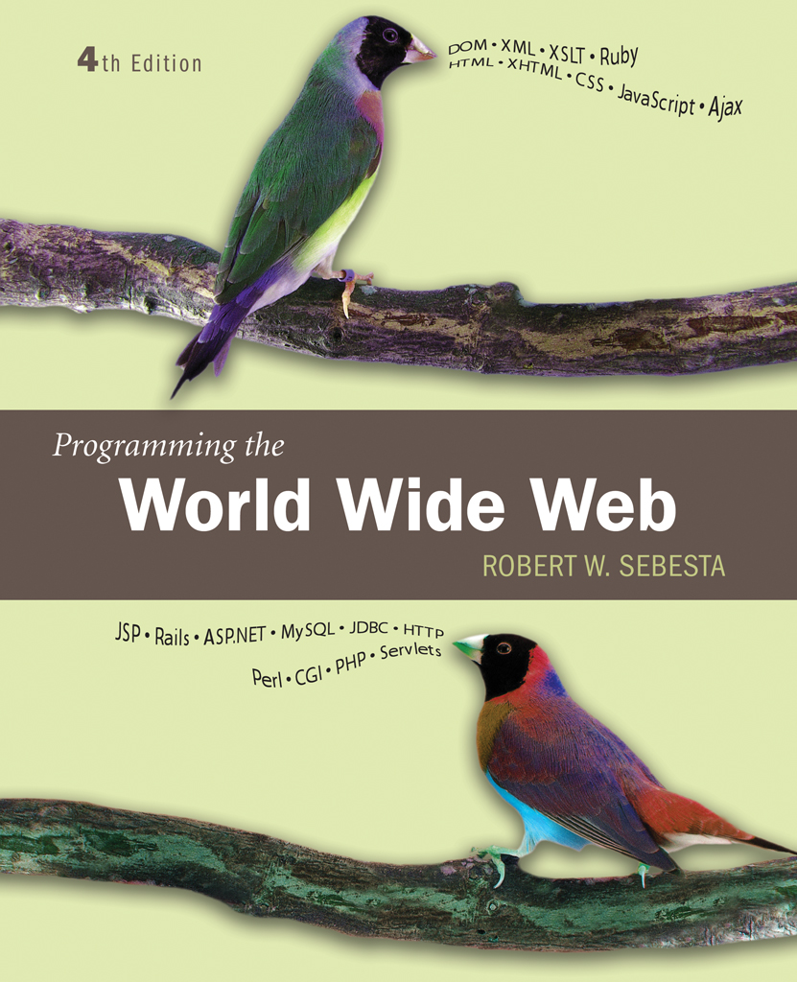
Chapter 8
The Basics
of Perl

Slide 2
Introduction
Perl is widely used for Common Gateway Interface (CGI) programming
Perl is useful in other contexts, so is a worthwhile additions to a programmers toolbox

Slide 3
8.1 Origins and Uses of Perl
Originally intended to combine and extend the processing functions of several Unix utilities including awk, sed, grep and sh
Developed by Larray Wall
Perl’s pattern matching ideas have been used in other languages and libraries
  Perl’s pattern matching extends ideas used in some of the Unix utilities
Perl is compiled to intermediate code, a virtual machine language, which is then interpreted

Slide 4
8.2 Scalars and Their Operations
Perl has three categories of variables/values: scalars, arrays, hashes
  Variables for each category are distinguished by the first symbol in the variable name
    $ for scalar
    @ for array
    % for hash
Scalars come in three kinds: numbers, character strings and references
  Numbers are stored internally as double-precision floating point
  Note that strings are considered scalars in Perl

Slide 5
8.2 Numeric Literals
Integer literals are a string of digits
  Integer literals can be written in hexademical, base 16, bu beginning the number with 0x or 0X
Floating-point literals have either decimal point or exponent or both

Slide 6
8.2 String Literals
String literals can be delimited by single or double quotes
Single quote delimiters do not allow any substitutions: no escape characters (other than \’ or \”), no variable interpolation
Double quote delimiters allow substitutions for escape characters and for variable interpolation

Slide 7
8.2 String Literals
The letter q is used to introduce a literal, single quoted string, bounded by an arbitrary character
  So q$abcdef$
The letter pair qq is used to introduce a literal, double quoted string, bounded by an arbitrary character
  So qq#abcdef#
If the beginning delimiter is one of ( < [ { then the matching delimiter must be ) > ] }, respectively
Then null string is ‘’ or “”
  Also known as the empty string

Slide 8
8.2 Scalar Variables
Scalar variable names begin with $, followed by letters digits and/or underscores
  Case sensitive
  Conventionally, programmer defined names do not use upper case letters
Scalar variable values are interpolated into double quoted strings
  If $x has the value 3
  Then “Value of x is $x” becomes “Value of x is 3”
Unassigned variables have the value undef
  undef converts to 0 as a number and the null string as a string
Perl has a large number of predefined variables
  Many are named with special characters, such as $_ and $^

Slide 9
8.2 Numeric Operators
Four arithmetic: + - * /
  Note that 5/2 is 2.5
Modulus: %
Exponentiation: **
Unary: -- ++

Slide 10
8.2 Operator Precedence
Operator | Associativity
++, -- | Nonassociative
unary +, - | Right
** | Right
*, /, % | Left
binary +, - | Left

Slide 11
8.2 String Operators
A string is a single unit, a scalar
The period, ‘.’, is used as the concatenation operator
  Note, note th ‘+’ as in many languages: Perl does not overload operators
If $a is “cant” then
  $a . “aloupe”
  is “cantaloupe”
The ‘x’ operator indicates repetition, so
  “=“ x 4
  is “====“

Slide 12
8.2 String Functions
Predefined unary operators can be used as functions by simply parenthesizing the operand
  Be wary of precedence changes since parentheses are the highest precedence

Slide 13
8.3 String Functions
Name | Parameter(s) | Actions
Chomp | A string | Removes any terminating newline characters* from its parameter; returns the number of removed characters
length | A string | Returns the number of characters in its parameter string
lc | A string | Returns its parameter string with all uppercase letters converted to lowercase
uc | A string | Returns its parameter string with all lowercase letters converted to uppercase
hex | A string | Returns the decimal value of the hexadecimal number in its parameter string
join | A character and the strings catenated together with a list of strings | Returns a string constructed by catenating the strings of the second and subsequent strings together, with the parameter character inserted between them

Slide 14
8.3 Assignment Statements
The assignment operator, ‘=‘, assigns a value to a variable
  The result returned is a reference to the assigned variable
Compound assignment operators are similar to C, C++ and Java
  $x *= 3 multiplies the value of $x by 3
Comments are signified in Perl by a # sign
  The remainder of the line is ignored

Slide 15
8.3 Keyboard Input
Perl treats all input and output as file input and output
Physical files have external names, but all files are referred to by internal names called filehandles
Certain filehandles are predefined
  STDIN is console input, usually the keyboard
  STDOUT is console output, usually the screen
  STDERR is console error output, usually the screen
  The execution environment of the Perl script my redirect these predefined handles to take input from other sources (such as a physical file) or put output to other targets
The line input operator, ‘<>’ reads a line of input (indlucing a newline character) from the filehandle
  $line = <STDIN> will read one line from standard input and assign it to $line

Slide 16
8.3 Standard Perl Usage
Since in most cases the terminating newline character is not desired, the chomp operator is used to remove it:
  $x = <STDIN>;
  chomp($x);
This is often abbreviated
  chomp($x = <STDIN>);
  The assignment operator returns a reference to $x which is passed to chomp

Slide 17
8.3 The Diamond Operator
Using <> without a filehandle has a special meaning in Perl
Each argument on the command line is interpreted as a file name
The lines are read from these files in succession
Standard input can be included by using a single hyphen as an argument: ‘-’

Slide 18
8.3 Screen Output
The print function takes as an operand a list of one or more strings separated by commas
  There is no newline character provided automatically, it must be literally included
A C-style printf function is available
Example quadeval.pl demonstrates input from the standard console and output to the standard console
  This program is run independently of browser or server. For example, it could be run from the command line

Slide 19
8.3 Perl from the Command Line
Perl programs are fun from the command line by using the perl interpreter
  perl quadeval.pl
Command flags can be added
  -w asks that warnings be reported for problematic programming
  -c asks for compilation without running
For example
  perl –w quadeval.pl
If the program were invoked like this
  perl –w quadeval.pl quad.dat
Then the input would be taken from the file quad.dat by using this input
  $input = <>

Slide 20
8.4 Control Statements
Perl provides a standard array of control structures for managing the flow of execution in programming

Slide 21
8.4 Control Expressions
Control statements depend on the value of control expressions to determine execution flow
Control expressions are, conceptually, either true or false
  A string value is true unless it is “” or “0”
    Note, that is literally, “0”: “0.0” is considered true
    The <FH> input operator returns an empty string if there is no more input in the filehandle, this is interpreted as false
    So, while($a = <FH>) { … } executes as long as there is input available from filehandle FH
  A numeric value is true unless it is 0
Control expressions usually involve relational operators
The following slides lists the relational operators
  Note that there are different operators for strings and for numbers
  Operands are coerced as needed to match the type of the operator

Slide 22
8.4 Relational Operators in Perl
Operation | Numeric Operands | String Operands
Is equal to | == | eq
Is not equal to | != | Ne
Is less than | < | lt
Is greater than | > | gt
Is less than or equal to | <= | le
Is greater than or equal to | >= | ge
Compare, returning -1, 0, or +1 | <=> | cmp

Slide 23
8.4 Relational Operators
The first six operators produce +1 if true or “” if false
The last operator produces
  -1 if the first operand is less than the second
  +1 if the first operand is greater than the second
  0 if the two operands are the same
Relational operators are nonassociative
  That is, $a < $b < $c is not syntactically valid in Perl

Slide 24
8.4 Boolean Operators
Perl provides two forms of boolean operators
! (not), && (and) and || (or) have precendence above the assignment operators but below other operators
and, or and not have precedence below any other operators
$a = <> or die “no input” parses as
  ($a = <>) or (die “no input”)
  This causes the program to terminate if no input is read from <>
  If there is input, the next line is assigned to $a
$a = <> || die “not input”; parses as
  $a = (<> || (die “no input”));
  This causes the program to terminate if no input is read from <>
  This causes $a to be assigned +1 if there is input!

Slide 25
8.4 Selection and Loop Statements
A block of statements in Perl is a sequence of statements enclosed in a pair of curly braces: { }
Control statements in Perl require blocks of statements as components rather than allowing single statements without the braces

Slide 26
8.4 Selection using if
The if statement syntax
  if( control-expression )
  block
  [ elsif( control-expression )
  block
  ... Repeated elsif clauses ]
  [ else
  block ]
[ ] indicates optional parts
The elsif part may appear 0 or more times
The until statement reverses the sense of the if
  An until has neither elsif nor else parts

Slide 27
8.4 Repetition in Perl
The basic repetition uses while:
  while( control-expression )
  block
The while executes the block as long as the control-expression is true
The until reverses the sense of the while
  until( control-expression )
  block
The until executes as long as the control-expression is false

Slide 28
8.4 The for Statement
Syntax of the for statement
  for(initial-expression; control-expression;
  increment-expression )
  block
  The initial and increment expressions can be mutliple expressions separated by commas
The last operator causes the loop to exit immediately

Slide 29
8.4 Loop Labels
A loop may be provided a label by prefixing a name and a colon to the beginning of the loop
A last operator can have a loop label as an operand
  In this case, the operator will cause exit from the loop with the given label even if it is not the smallest loop containing the statement executing last

Slide 30
8.4 The Variable $_
The variable $_ is often an implicit operand for operators in Perl
The statement print; will print the value of $_
The statement chomp; will ‘chomp’ the value of $_
Using the <STDIN> input without assigning explicitly to a variable causes the value to be assigned to $_
Be aware that overuse of $_ can make programs difficult to follow

Slide 31
8.5 Fundamentals of Arrays
An array holds a list of scalar values
  Note that an array holds scalars, not other arrays or hashes
Different types of scalar data can be in the same array
Arrays have dynamic size, that is, they can increase and decrease in size as a program executes

Slide 32
8.5 List Literals
A list literal is given as a pair of parentheses enclosing a list of values separated by commas
Note that if a ‘sub-list’ is include as in (‘a’, (‘b’, ‘c’), ‘d’), then the list is flattened to (‘a’, ‘b’, ‘c’, ‘d’)
  References are used to include arrays as elements in arrays

Slide 33
8.5 Arrays
An array is a variable that stores a list
The name of an array variable begins with the character @
An array variable may be assigned a literal list value
  @a = (1, 2, ‘three’, ‘iv’);
An array assignment creates a new array as a copy of the original
  @b = @a;

Slide 34
8.5 Scalar and List Context
An expression in Perl is evaluated in a context
For example in the assignment
  $a = expression ;
The expression on the right is evaluated in a scalar context
On the other hand, in
  @a = expression;
The expression on the right is evaluated in a list context
An array or list evaluated in a scalar context evaluates to the length of the list

Slide 35
8.5 Parallel Assignment
A list of values can be assigned to a list of variables
($a, $b, $c) = (1, 2, “iii”);
causes $a to get the value 1, $b to get the value of 2 and $c to get the value “iii”
Note that the right se is evaluated before the assignment, so
($x, $y) = ($y, $x)
actually swaps the values of the two variables
If the target includes an array variable, all remaining values in the expression list are assigned to the list variable

Slide 36
8.5 Accessing an Array Element
The elements in an array are indexed by integers, beginning with 0
Element index 1 of list @alist is accessed as $alist[1]
Note that $ is used since the element is a scalar
Note also that there is not relationship between the scalar variable $alist and the list element $alist[1]
Assigning to an array element may cause the array to expand to accommodate the element
@a = (‘a’, ‘b’, ‘c’);
$a[20] = ‘outfield’;
Causes the array @a to expand to size 21
The last subscript in the array @a is $#a

Slide 37
8.5 foreach Statement
The foreach allows convenient iterating through the elements of an array or list
foreach $x (@a) { …. }
Executes the body of the loop for each element of the array @a
In each iteration, $x is an alias for the element
  That is, if $x is changed, the corresponding element of the array is changed

Slide 38
8.5 Built-In Array Functions
Four functions are provided by Perl to support stack and queue operations on arrays
push @a, $x; inserts the value $x at the end of the array @a
pop @a; removes the last value of @a and returns it
shift @a; removes the first value of @a and returns it
  All the remaining elements of @a are shifted down one index, hence the name
unshift @a, $x; inserts the value $x at the beginning of the array @a
  All the remaining elements of @a are shifted up one index

Slide 39
8.5 Build-In List Functions
The split function breaks strings into parts using a character to separate the parts
The sort function sorts a list using string comparison
  A more general usage is presented later
  sort does not alter the parameter but returns a new list
The qw (quote words) function creates a list of words from a string
The die operator displays its list operand and then terminates the program

Slide 40
8.5 Example
The process_names.pl example illustrates using arrays
The example also uses the ‘diamond’ operator <>

Slide 41
8.6 Hashes
An associative array uses general data, often strings, as indexes
  The index is referred to as a key, the corresponding element as a value
Since a hash table is often used to implement an associative array, these structures are known as hashes in Perl
Elements in a Perl hash do not have a natural ordering
  When a list of keys is retrieved from a hash there is no definite relationship between the order of the keys and either the values of the keys or the order in which they were entered into the hash

Slide 42
8.6 Hash Variables
Hash variables are named beginning with the character %
If an array is assigned to a hash, the even index elements become keys and the odd index elements are the corresponding values
  Assigning an odd length array to a hash causes an error
Curly braces are used to ‘subscript’ a hash
  If %h is a hash, then the element corresponding to ‘four’ is referenced as $h{‘four’}

Slide 43
8.6 Changing a Hash
Values can be assigned to a hash reference to insert a new key/value relation or to change the value related to a key
A key/value relation can be removed from a hash with the delete operator
The undef operator will delete all the contents of a hash
The exists operator checks if a key is related to any value in a hash
  Just check $h{‘something’} doesn’t work since the related value may be the empty string or 0, both of which count as boolean foalse
A hash variable embedded in a string is not interpolated
  However, a reference to a hash element is interpolated

Slide 44
8.6 Iterating Through a Hash
The keys operator returns a list of the keys in a hash
The sort operator can also be applied to iterate through the keys in order

Slide 45
8.6 A Predefined Hash
The %ENV variable is defined to be the key/value pairs defined in the environment of the running Perl process
Many of these are inherited from the run-time environment
In Microsoft Windows, environment variables can be set through the command-line set command
In Unix Bourne shell, environment variables may be set by a simple assignment

Slide 46
8.7 References
A reference is a scalar value giving the address of another value in memory
A reference to an existing variable is created by using the backslash operator
References to literal structures can be created
  A reference to a list is created by enclosing a list in square brackets, […]
  A reference to a hash is created by enclosing a list in curly braces {…}
  For example $a = [1, 2, 3, 4]
  For example $h = {‘i’ => 1, ‘v’ => 5, ‘x’ => 10};
  Notice the assignment is to a scalar variable since the literal value is a reference

Slide 47
8.7 Dereferencing References
To access the value pointed to by a reference, the programmer must explicitly dereference the reference
An extra $ sign can be used
  If $a = 5 and $b = \$a then $$b is 5
  $$b = 7 changes the value of $a to 7
In a reference to an array, -> can be used between the reference and the index to indicate a dereference
  If $r = \@list then $$r[3] is the element at index 3 of @list
  $r->[3] is also the element at index 3 of @list
  $r[3] is the element at index 3 of @r, completely unrelated

Slide 48
8.8 Function Fundamentals
A function definition consists of a function header and the body
  The body is a block of code that executes when the function is called
  The header contains the keyword sub and the name of the function
A function declaration consists of the keyword sub and the function name
  A declaration promises a full definition somewhere else
A function call can be part of an expression. In this case the function must return a value that is used in the expression
A function call can be a standalone statement. In this case a return value is not required. If there is one, it is discarded

Slide 49
8.8 Function Return
When a function is called, the body begins executing at the first statement
A return statement in a function body causes the function body to immediately cease executing
  If the return statement also has an expression, the value is returned as the value of the function
  Otherwise, the function returns no value
If execution of a function reaches the end of the body without encountering a return statement, the return value is the value of the last expression evaluated in the function

Slide 50
8.8 Local Variables
Variables that are not declared explicitly but simply assigned to have global scope
The my declaration is used to declare a variable in a function body to be local to the function
If a local variable has the same name as a global variable, the global variable is not visible within the function body
Perl also supports a form of dynamic scoping using the local declaration
  A my declaration has lexical scope which works like scope rules in C, C++ and Java

Slide 51
8.8 Parameters
Parameters used in a function call are called actual parameters
Formal parameters are the names used in the function body to refer to the actual parameters
In Perl, formal parameters are not named in the function header
Perl supports both pass-by-value and pass-by-reference
The array @_ is initialized in a function body to the list of actual parameters
  An element of this array is a reference to the corresponding parameter: changing an element of the array changes the corresponding actual parameter
Often, values of @_ are assigned to local variables which corresponds to pass-by-value

Slide 52
8.8 Parameter Usage Examples
This code causes the variable $a to change
  sub plus10 {
  $_[0] += 10;
  }
  plus10($a);
The first line of this function copies actual parameters to local variables
  Sub f {
  my($x, $y) = @_;
  }

Slide 53
8.8 Passing Structures as Parameters
An array or hash will be flattened if included directly in an actual parameter list
A reference to a hash or array will be passed properly since the reference is a scalar value

Slide 54
8.8 sort Revisited
The sort function can be called with the first parameter being a block which returns a numerical value based on the comparison of two variables $a and $b
This parameter is not followed by a comma
For example, using
sort {$a <=> $b} @num
will sort the array @num using numerical comparison
Using
sort {$b <= > $a} @num
will sort in reverse order

Slide 55
8.8 Example
The example tst_median illustrates a function that finds the median of an array passed as a reference value

Slide 56
8.9 Basics of Pattern Matching
Perl has powerful pattern matching facilities built in
  These have been imitated in a number of other systems
  Regular expressions were described in the JavaScript chapter
The m operator indicates a pattern matching
  This is used with delimiters like q and qq but the enclosed characters form a pattern
  If the delimiter is / then the m is not required
A match is indicated by the =~ operator with a string on the left and a pattern on the right
  A pattern alone is matched by default to $_
The split function can take a pattern as the first argument rather than a character
  The pattern specifies the pattern of characters used to split the string apart

Slide 57
8.9 An Example
Example word_table.pl uses a pattern to split a text into words
A hash table is used to count the frequency of each word
  The keys are the words, the corresponding values are the counts of the words in the text
The exists function is used to tell if a word is already entered into the hash

Slide 58
8.9 Remembering Matches
Parts of a pattern can be parenthesized
If the pattern matches a string, the variables $1, $2, … refer to the parts of the string matched by the parenthesized sub-patterns
If a match is successful on a string, three strings are available to give the context of the match
  $& is the part that actually matched the pattern
  $` is the part of the string before the part that matched
  $’ is the part of the string after the part that matched

Slide 59
8.9 Substitutions
The s operator specifies a substitution
  s/pattern/new-string/
The new-string will replace the part of a string matched by the pattern
The =~ operator is used to apply the substitution to a string
  If the operator is not used, $_ is operated on by default
A g modifier on the substitution causes all substrings matching the pattern to be replaced, otherwise only the first match is changed
The i modifier cause the pattern match to be case insensitive

Slide 60
8.9 The Transliterate Operator
This is written tr/char-list1/char-list2/
When applied to a string it causes each character of the string that appears in the first list to be replaced by the corresponding character in the second list
If the second list is empty, the characters from the first list are deleted from the string
The =~ operator is used to apply the transliteration
  If the operator is not used, $_ is operated on by default

Slide 61
8.10 File Input and Output
To carry out file input and output, a filehandle must be created for each file
The open function is used to create a file handle
  The first parameter to open is the name of a file handle
    By convention the name is all capital letters
  The second parameter to open is a string value naming the file and, optionally, including a character to indicate the mode of opening the file
    < indicates open for input (default)
    > indicates open for output, deleting the content of an existing file
    >> indicates open for output, appending to a file that already exists

Slide 62
8.10 Input and Output Operations
The print function is used to send output to a filehandle
  print OUTHANDLE “data”, “more data”;
  Note that there is not comma after the OUTHANDLE
  This is important, otherwise the value of the handle will be displayed on the output console
The input operator <> can be used on an input file handle
The read function reads a number of characters into a given array
  The function returns actual number of characters read
  The function parameters can indicate that characters are to be stored in the array somewhere other than at the beginning
The seek function can be used to position the filehandle cursor at a different position in the file

Slide 63
8.11 Example
The example wages.pl illustrates many of the features of Perl
An input file contains lines of data with fields separated by colons
  The split function can be used to separate the fields
Pattern matches are used on names
A hash is used to store employees and their salaries

